Slide 1
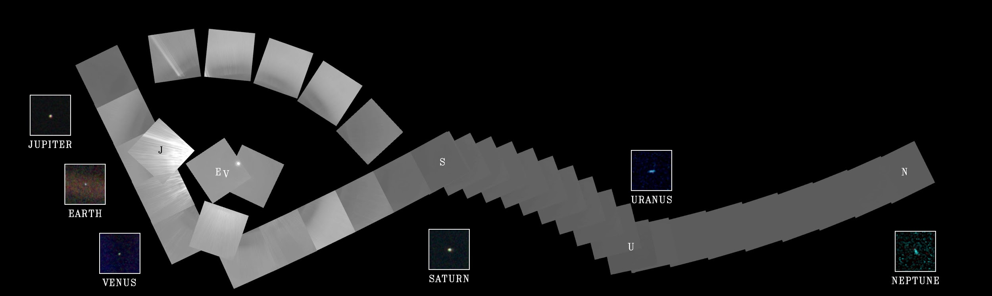
AE673A
Group Number- 3
Mataria Pence Jagatkumar (170382)
Amrendra Pratap Singh (170097)
Aditya Raghuwanshi (170052)

Slide 2
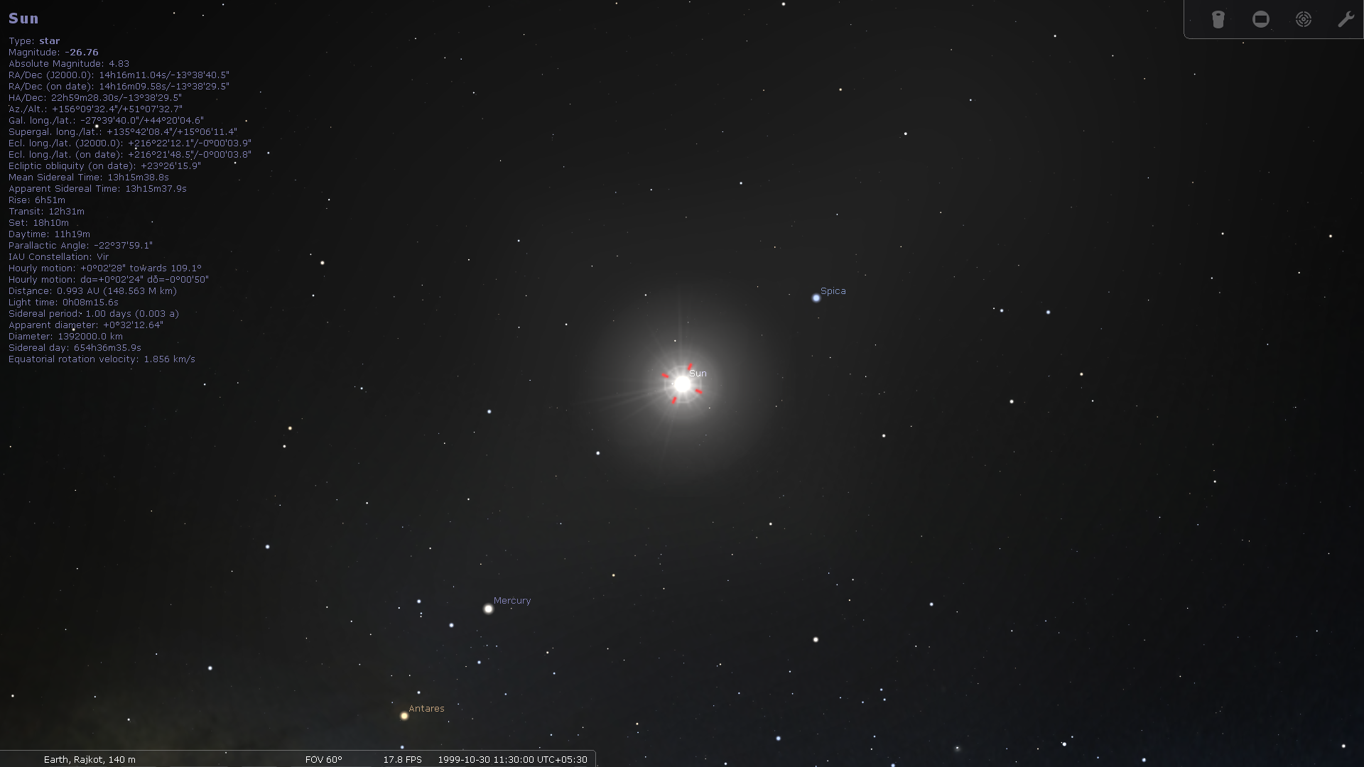
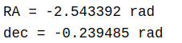
MATLAB Values
Upon Conversion of Sterillium values,
RA= -2.6226 rad
declination= -0.2381 rad
RA and Declination values from both the sources are nearly same. Hence our MATLAB code is perfectly good for this
Solar Objects | RA | Declination | Altitude | Azimuth
Sun | 14h16m09.58s | -13º38’29.5” | +51º07’32.5” | +156º09’32.4”

Slide 3
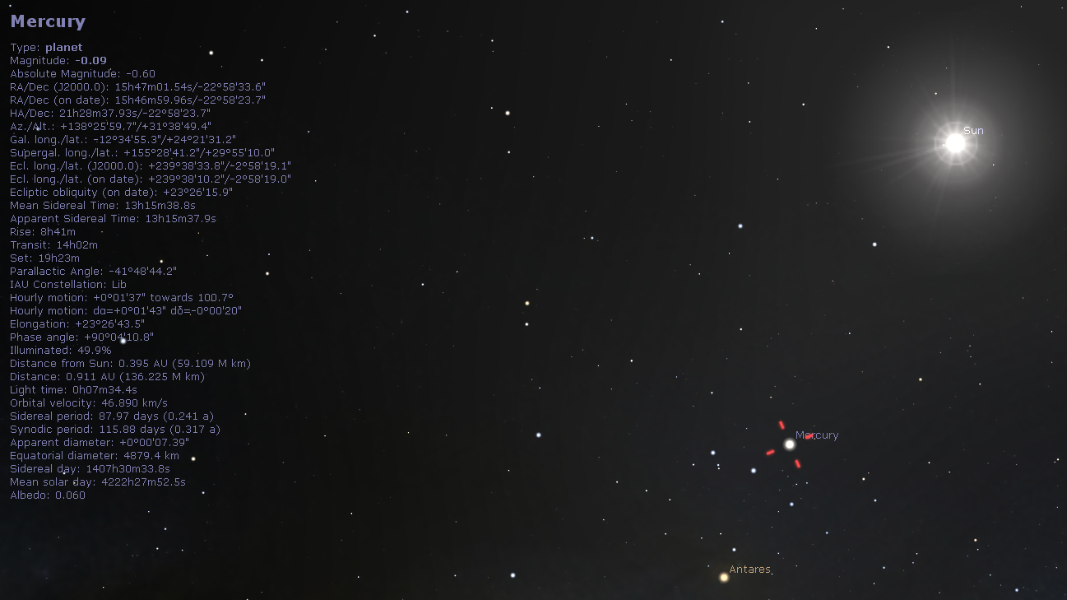
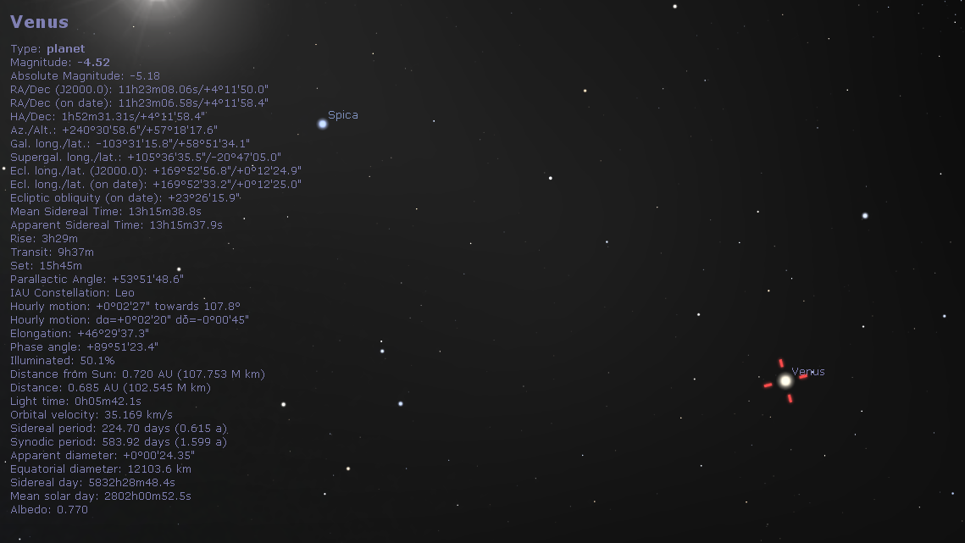
Solar Objects | RA | Declination | Altitude | Azimuth
Mercury | 15hr46m59.96s | -22º58’23.7’’ | +31º38’49.4’’ | +138º25’59.7’’
Venus | 11h23m06.58s | +4º11’58.4” | +57º18’17.6” | +240º30’58.6”

Slide 4
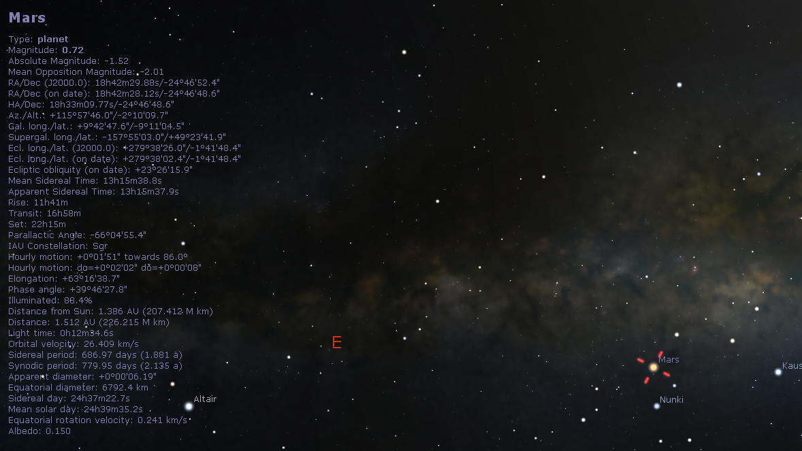
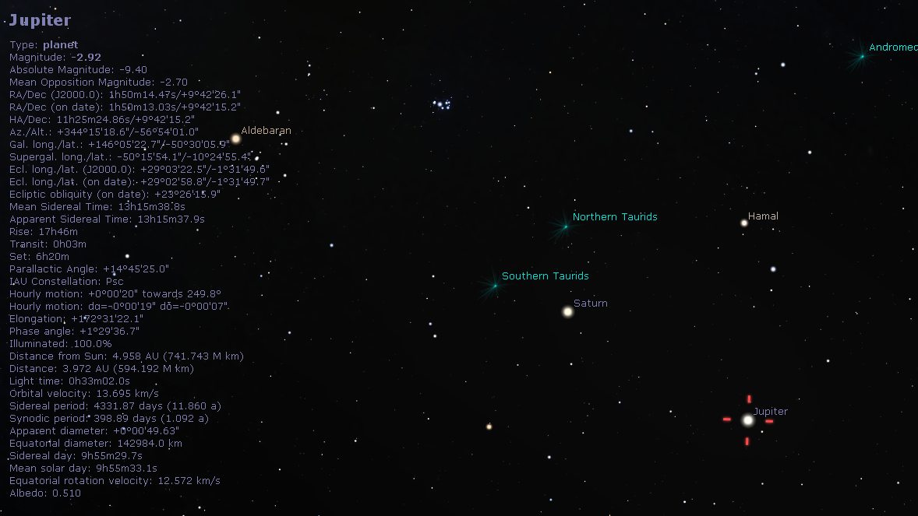
Solar Objects | RA | Declination | Altitude | Azimuth
Mars | 18h42m28.12s | -24º46’48.6’’ | -02º10’09.7’’ | +115º57’46.0’’
Jupiter | 01h50m13.03s | +09º42’15.2’’ | -56º54’01.0’’ | +344º15’18.6’’

Slide 5
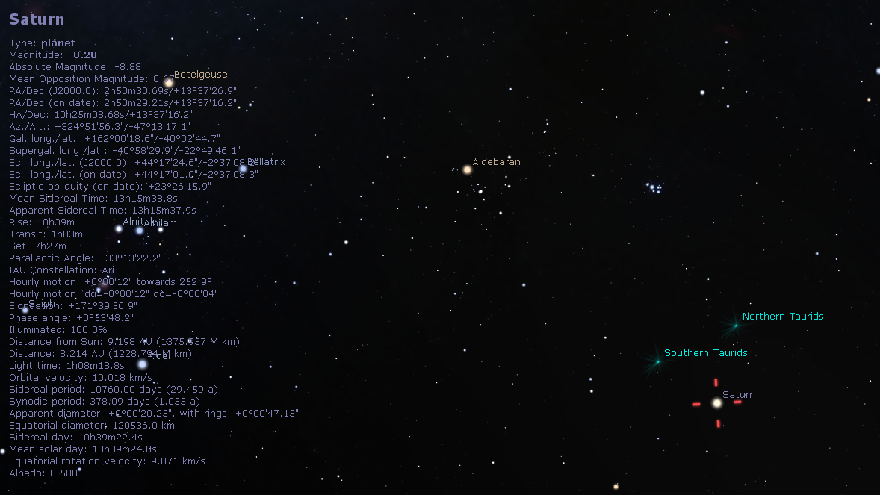
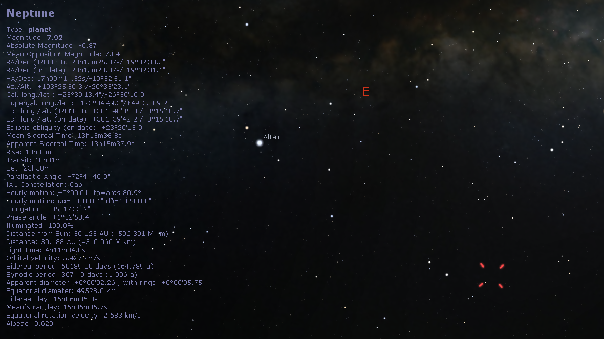
Solar Objects | RA | Declination | Altitude | Azimuth
Saturn | 2h50m29.21s | +13º37’16.2” | -47º02’44.7” | +324º51’56.3”
Neptune | 20h15m23.37s | -19º32’31.1” | -20º35’23.1” | +103º25’30.3”

Slide 6
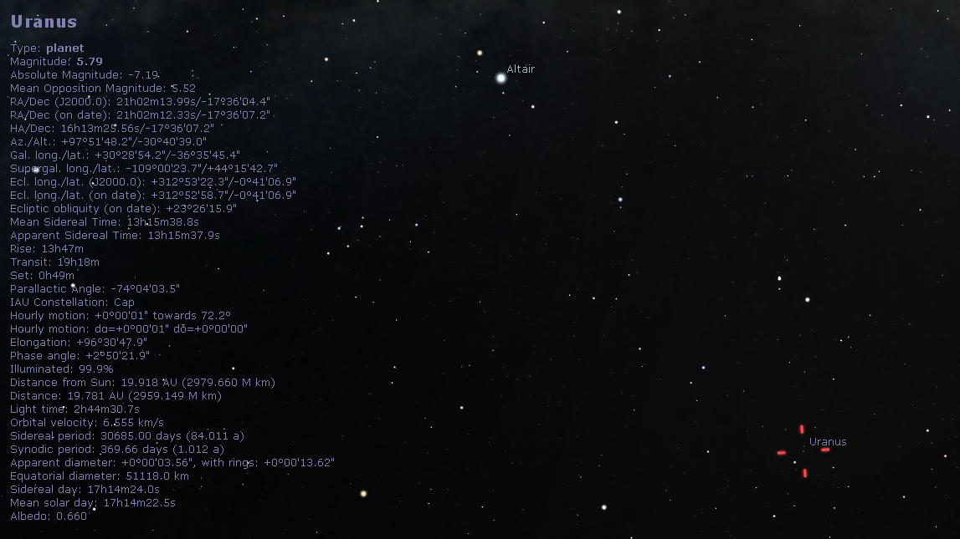
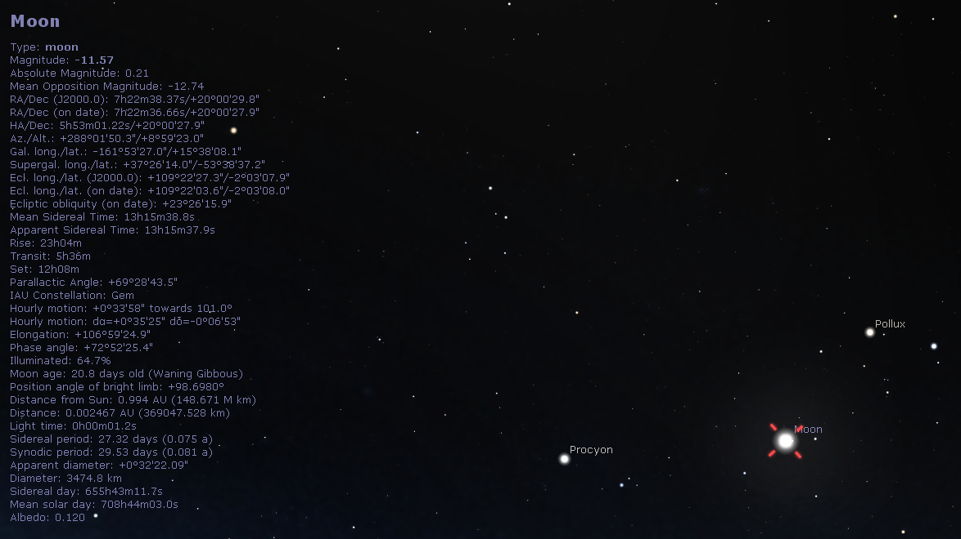
Solar Objects | RA | Declination | Altitude | Azimuth
Moon | 07h22m36.66s | +20º00’27.9’’ | +8º59’23.0 | +288º01’50.3’’
Uranus | 21h02m12.33s | -17º36’07.2” | -30º40’39.0” | +97º51’48.2”

Slide 7
[RA,delta] = SolarAzElq('1999-10-30 11:30:00',22.2913,70.7930,140);
fprintf('RA = %f rad \n',RA)
fprintf('dec = %f rad \n',delta)
function [RA,delta] = SolarAzElq(UTC,Lat,Lon,Alt)
if nargin<4 || isempty(Alt), Alt = 0; end
d2r = pi/180; %radiance to degrees conversion factor
r2d = 180/pi; %radiance to degrees conversion factor
if ischar(UTC)
UTC = cellstr(UTC);
end
if iscell(UTC)
UTC = reshape(datenum(UTC(:),'yyyy-mm-dd HH:MM:SS'),size(UTC));
end
[year,month,day,hour,min,sec] = datevec(UTC);
if ndims(UTC)>2 %#ok<ISMAT>
year = reshape(year ,size(UTC));
month = reshape(month,size(UTC));
day = reshape(day ,size(UTC));
hour = reshape(hour ,size(UTC));
min = reshape(min ,size(UTC));
sec = reshape(sec ,size(UTC));
end
[jd,UTH] = juliandate(year,month,day,hour,min,sec);
day = jd - 2451543.5;
w = 282.9404 + 4.70935e-5 * day;
e = 0.016709 - 1.151e-9 * day;
M = mod(356.0470 + 0.9856002585 * day, 360);
L = w + M;
oblecl = (23.4393 - 3.563e-7 * day)*d2r;
E = M + r2d*e.*sin(M*d2r).*(1+e.*cos(M*d2r));
x = cos(E*d2r)-e;
year = sin(E*d2r).*sqrt(1-e.^2);
r = sqrt(x.^2 + year.^2);
v = atan2(year,x)*r2d;
lon = v + w;
xeclip = r.*cos(lon*d2r);
yeclip = r.*sin(lon*d2r);
zeclip = 0;
xequat = xeclip;
yequat = yeclip.*cos(oblecl) + zeclip*sin(oblecl);
zequat = yeclip.*sin(0.409115648642983) + zeclip*cos(oblecl);
r = sqrt(xequat.^2 + yequat.^2 + zequat.^2) - (Alt/149598000);
RA = atan2(yequat,xequat); % in radians
delta = asin(zequat./r); % in radians
end
function [jd,UTH] = juliandate(year,month,day,hour,min,sec)

